Slide 1

The web and Internet
The world wide web, or web for short, are the pages you see when you're at a device and you're online. But the internet is the network of connected computers that the web works on, as well as what emails and files travel across. Think of the internet as the roads that connect towns and cities together.

Slide 2
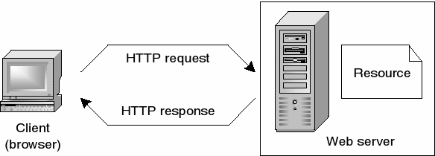
How Does The Web Work ?
• Web servers and web browser communicate via HTTP
• HTTP ensures that all parts of the web page are delivered
• Web browser decides how these items are displayed

Slide 3

The browser sends an HTTP request message to the server, asking it to send a copy of the website to the client. This message, and all other data sent between the client and the server, is sent across your internet connection using TCP/IP.

Slide 4
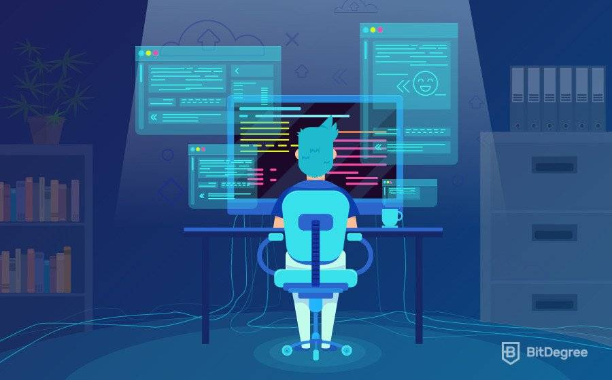
What do you need to be a web developer?
To become a Web Developer, you should have an understanding of HTML, CSS, and JavaScript.
It's also recommended to learn about CSS and CSS frameworks. Developing these fundamental web development skills will give you the foundation and logic for communicating with programming languages.
Backend developers are responsible for creating the logic that runs on a server which typically involves communicating with a database and manipulating data, before passing it back to the browser and presenting to the user. Typical programming languages used are PHP, Ruby, ASP are SQL.
Web developers can be split into two different areas of responsibilities and skills - frontend and backend.
Frontend developers focus on programming languages such as HTML, CSS and JavaScript to create the visual and interactive parts of a website - essentially the parts you can see.
Web developers carry out vital work that sustains our digital society. These professionals create websites and work behind the scenes to ensure that applications run smoothly. They provide stability, add visual flair, and integrate the platforms that house our data.

Slide 5
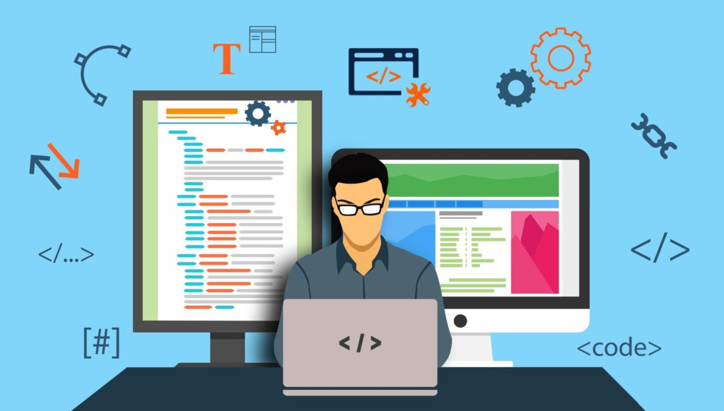
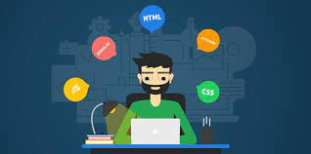
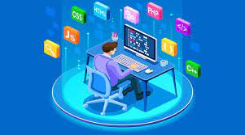
Why did I choose to learn web development?
I chose to Learn web development because it’s a highly demanding career. It has a high salary potential and growing flexibility, plus it’s easy to find a job.
Coding provides a unique creative platform as it allows you to design different aspects of a website, such as creating visual site layouts…., which means you have the opportunity to express yourself creatively on the internet.
In today’s digital and technological era, websites are essential elements for establishing and elevating your corporate business identity. No organization can sustain and rise without having a strong physical website presence.

